Slide 2

Practical Terahertz Communication
A Quick Introduction to the TWISTER System and Practical DSP Concerns

Slide 3
What is the TWISTER system?
Transformative Wideband continuous-wave Instrument for Science, Technology, Education, and Research
TWISTER

Slide 4
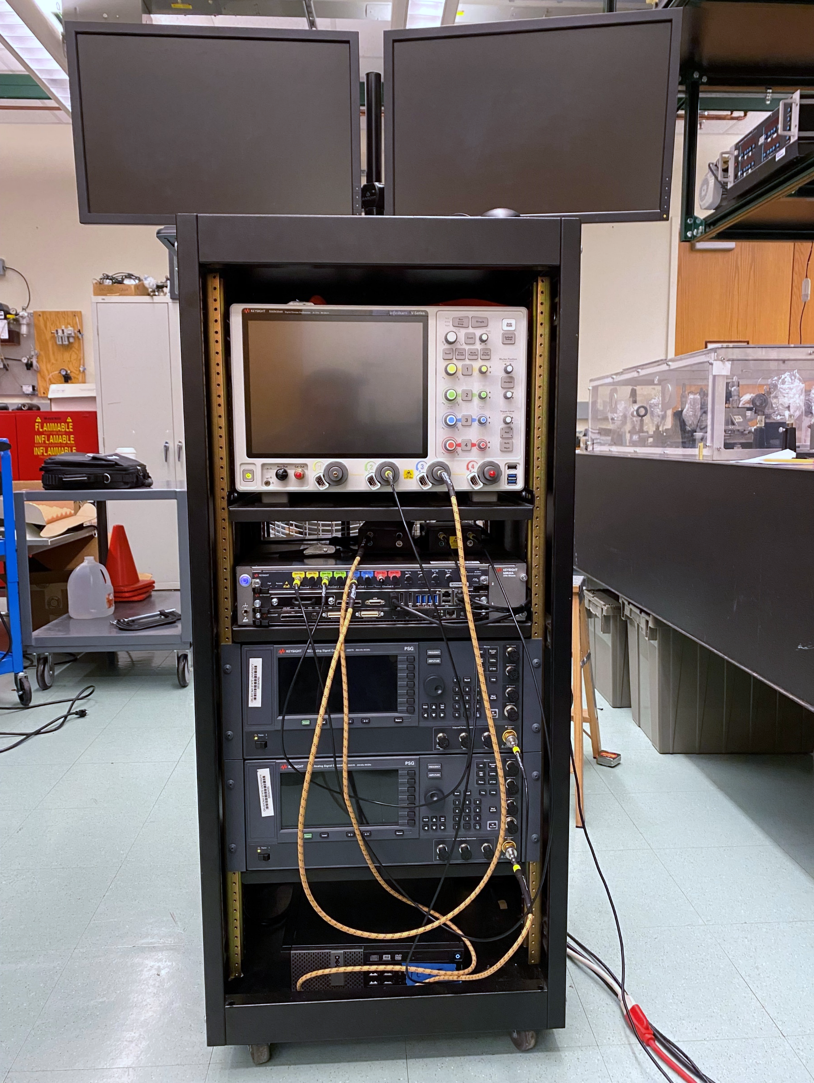
The TWISTER System - Overview
It’s not an MRI machine.
Major Research Instrumentation
Keysight M8195A Arbitrary Waveform Generator
Virginia Diodes Compact Up & Down Converter Set
Two Keysight E8257D Analog Signal Generators
Keysight DSOV254A Digital Oscilloscope
Minor Research Instrumentation
Control PC
Assorted 2.92mm Cables
Antennas (horns, dishes, lenses)
Mini-Circuits ZVA-203GX+ LNA
Sketchy home-brew terahertz absorbers
Coming Soon!
Rubidium Oscillator
130 GHz wideband amplifier
High-gain dish antennas

Slide 5
The Majors
Important, expensive stuff you really don’t want to break
TWISTER

Slide 6
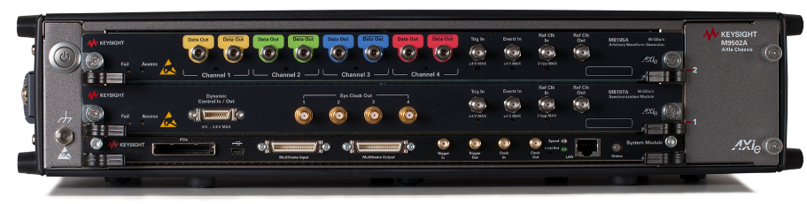
The M8195A Arbitrary Waveform Generator
It generates arbitrary waveforms!
Key Specifications
Up to 65 billion output samples per second (GSa/s) per channel.
16 GSa of waveform memory.
4 Channels*
Maximum single-channel bandwidth: 32.5 GHz
At 65 Gsa/s, the maximum waveform duration in 0.2462 seconds.

Slide 7
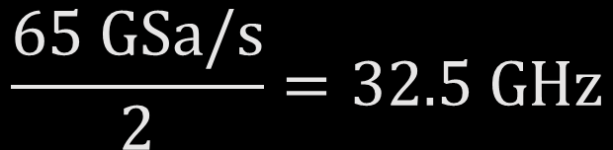
Important Aside #1: Nyquist Criterion -
Nyquist Criterion
You must sample a waveform at twice the bandwidth (or faster) to preserve all information present.
You must sample at twice the highest frequency (or faster) to avoid aliasing.
The same apply when generating a signal.
$$\frac{65 \text{GSa}\text{/}\text{s}}{2}{=32.5 \text{GHz}}$$

Slide 8
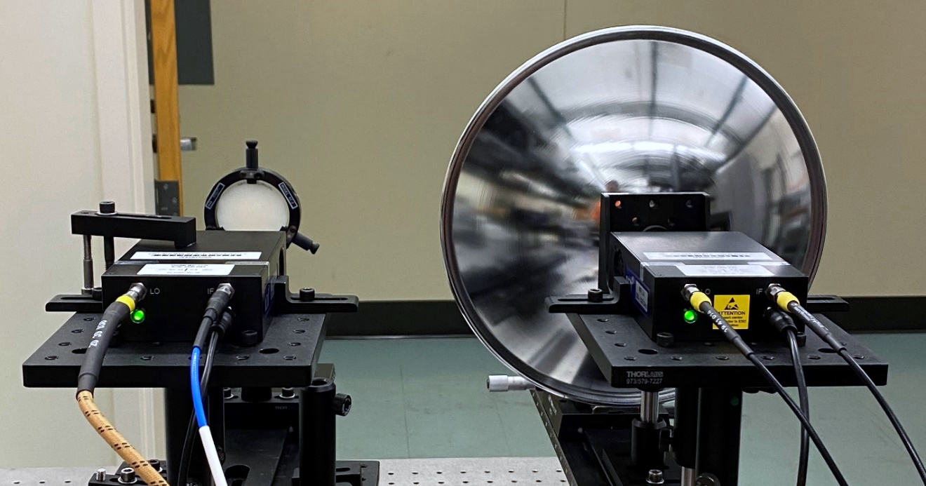
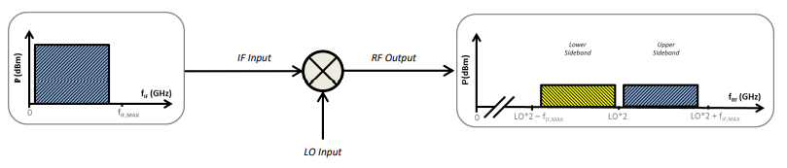
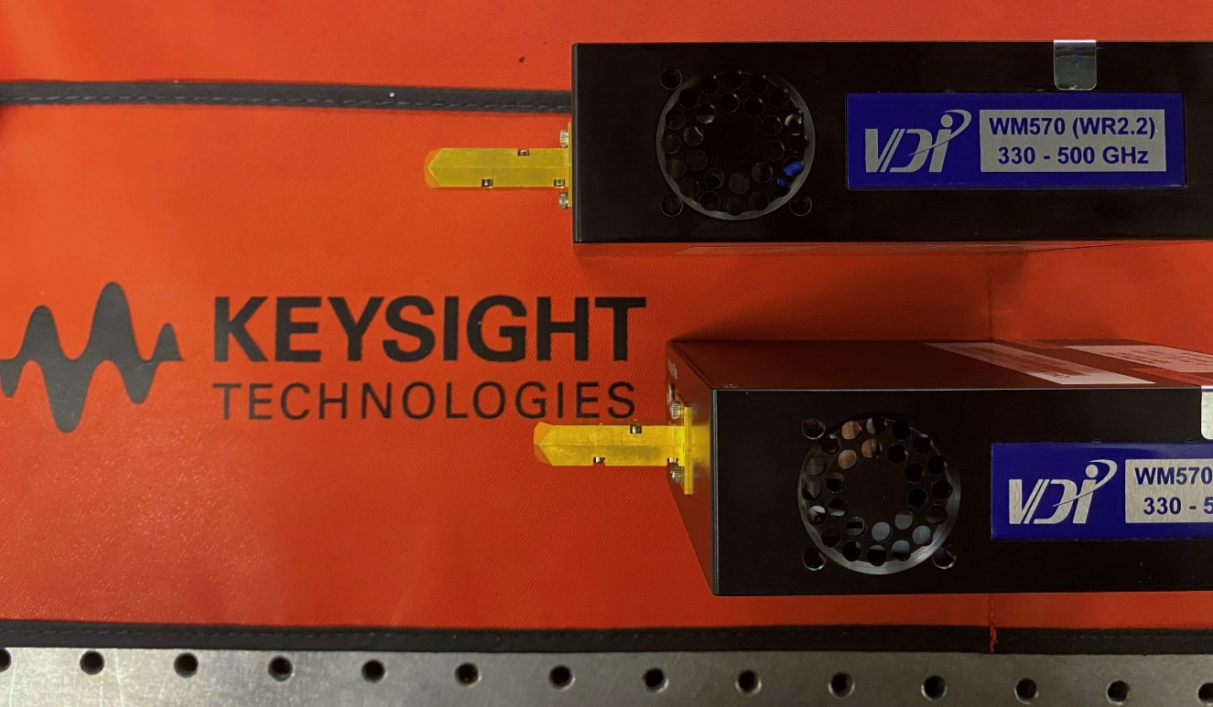
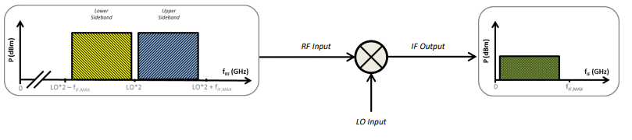
VDI Up and Down Converters
Up-conversion and mixing in one convenient package!
Key Takeaways
Takes in a local oscillator (LO), multiplies it to a higher harmonic, then finally mixes it with an intermediate frequency (IF) RF signal.
We have 4 VDI module pairs that collectively span 110-500 GHz.
Important Note: The VDI modules produce a double-sideband signal!

Slide 9
Important Aside #2: Harmonics -
Generating Harmonics
Rectifying a signal generates harmonics.
In general, a nonlinear medium is needed to make harmonics.

Slide 10

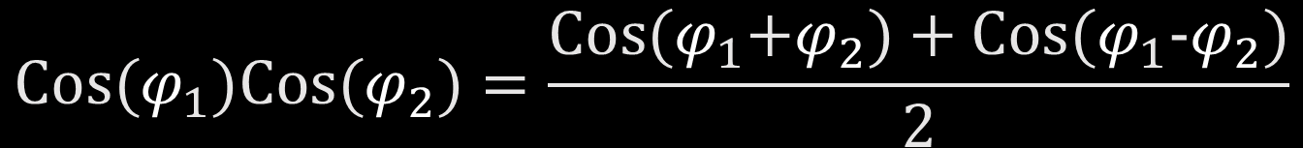
Important Aside #3: Mixing -
Important Concept
Multiplying two sinusoids together produce two sinusoids:
One at the sum frequency, and one at the difference frequency.
$$\text{Cos}\text{(}φ_{1}\text{)}\text{Cos}\text{(}φ_{2}\text{)}{=\frac{\text{Cos}\text{(}φ_{1}\text{+}φ_{2}\text{) + }\text{Cos}\text{(}φ_{1}\text{−}φ_{2}\text{)}}{2}}$$
$2πf={\frac{d}{dt}φ\left(t\right)}$
By generating and mixing harmonics, you can produce any integer multiple of the original sinusoid.
(Note: Your efficiency may be poor)

Slide 11
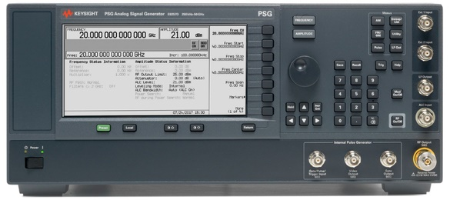
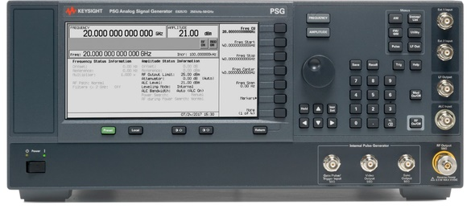
E8257D PSG (Analog Signal Generators)
They make signals the old-fashioned way!
Key Takeaways
Output frequency from 100 kHz to 40 GHz.
Output power up to 14 dBm.
… but why?

Slide 12
Digitization Noise
Digital waveforms aren’t necessarily clean.
Digitization noise is caused by finite digital precision.

Slide 13
Digitization Noise
Digital waveforms aren’t necessarily clean.
Another Example

Slide 14
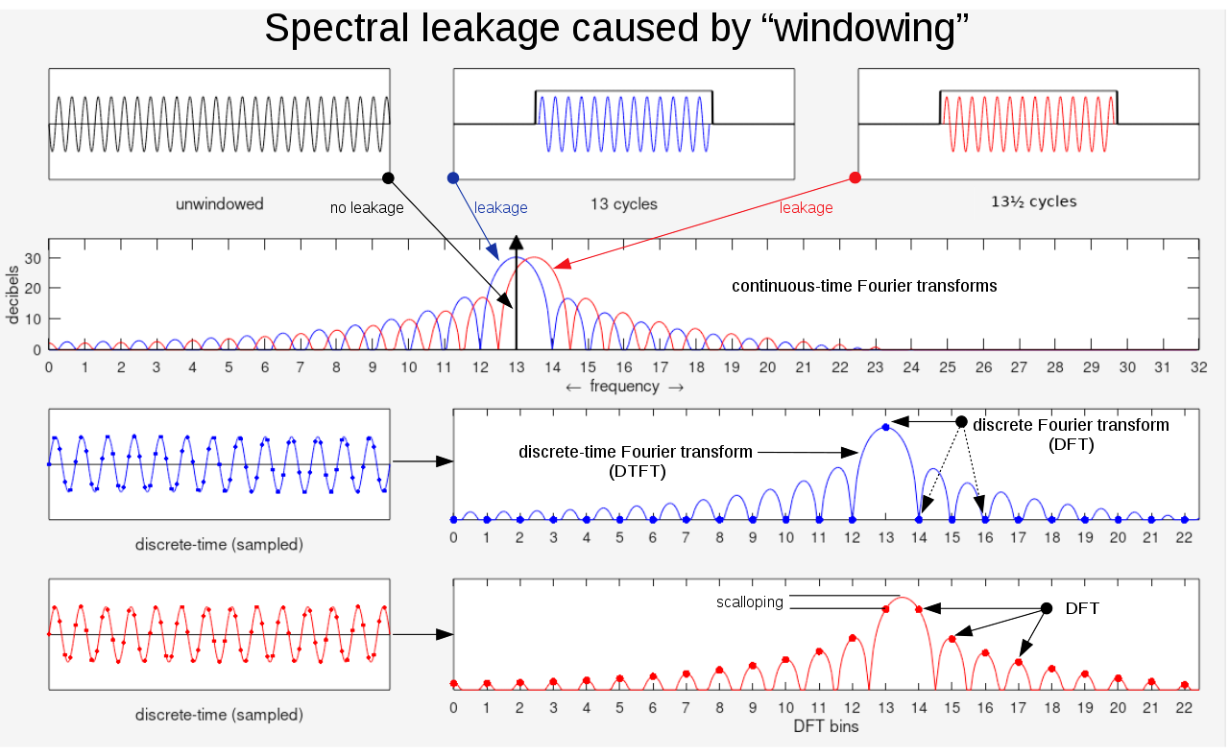

Slide 15
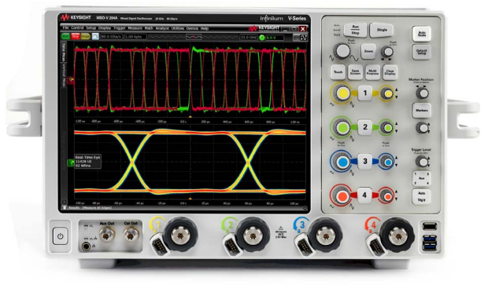
The DSOV254A Digital Oscilloscope
It sees all.
Key Takeaways
It captures all the signals that we produce.
Maximum sample rate of 80 GSa/s.
That’s 12.5 picoseconds between samples.
Memory depth is 205 MPts / channel.
Practical Note: The front-end amplifier is only 25 GHz.
Who puts male connectors on a scope!?

Slide 16
The Minors
Stuff you didn’t think about, but should have.
TWISTER

Slide 17
Practical Considerations
They don’t show you this on system block diagrams!
Unsung heroes
Big ‘ole box fan to keep the rack cool. → You’ll void calibration without it.
Broadband multipath absorbers. → Your antenna characterizations will be garbage without them.
Antenna systems. → Without high gain, you’ll never overcome path loss.
2.92mm cables and adapters. → Ever tried to connect two male connectors together? Doesn’t work.
The Low-Noise Amplifier (LNA).

Slide 18
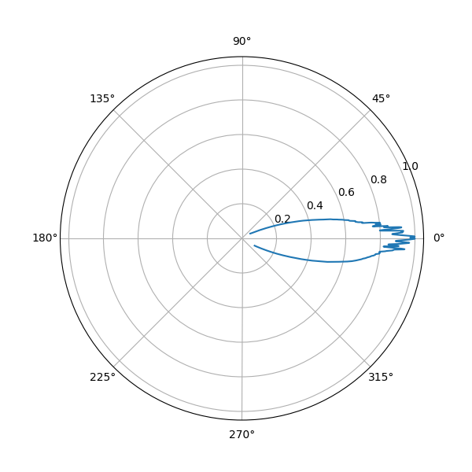
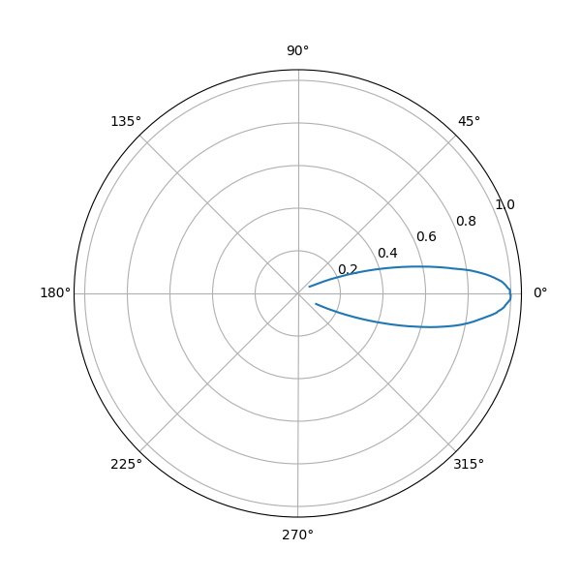
Multipath Propagation and Standing Waves
Key Takeaways
The antenna beamwidth is ~11°, and within this angle, multipath interference can occur for a line-of-sight (LOS) link.
More isn’t always merrier.
VERSUS
TX
RX
Practical Note: Sometimes all you need is a bag of water!

Slide 19
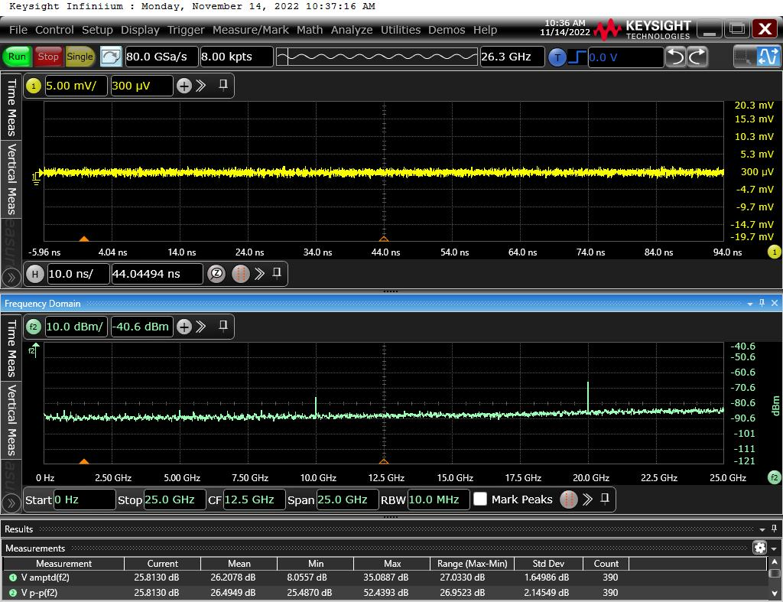
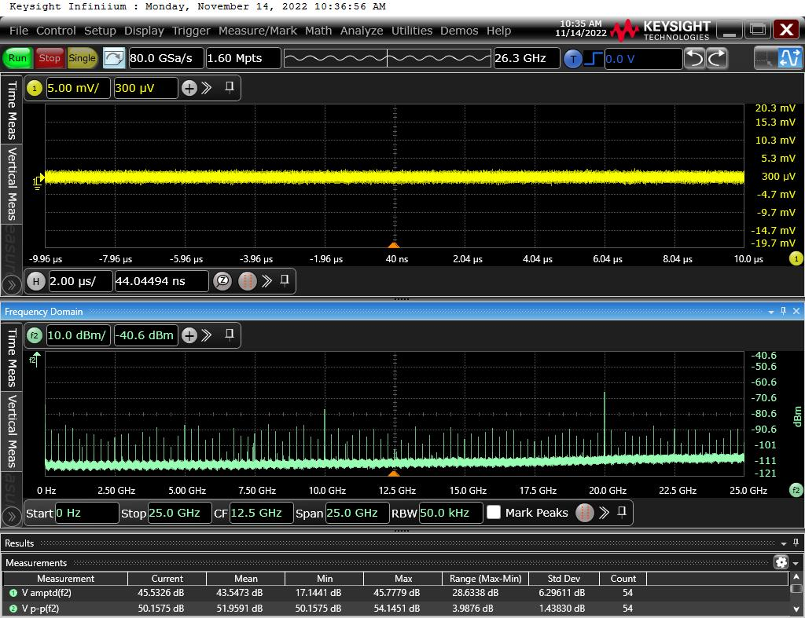
Low-Noise Amplifier - Justification
Problem: Noise spurs on the oscilloscope.
These are intrinsic to the scope, and set the true noise floor of your measurement.

Slide 20
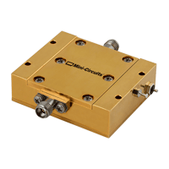
Low-Noise Amplifier - Effect
Wait, what?
The ZVA-203GX+ : A helpful amplifier with unhelpful terminals
Key Takeaways
Ask: is your noise level set by your signal, or by your instrument? → You may need an LNA.
Attack the limiting factor on your SNR.
Increased frequency resolution does not lower your noise floor!

Slide 21
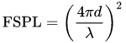
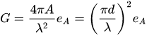
Antenna Systems
Horns, Dishes, and Lenses – oh my!
Practical Issue: Lenses versus horns versus dishes
Practical Issue: Unlimited gain?

Slide 22
Sending a 305 GHz Sine Wave
How hard can it be?
TWISTER

Slide 23
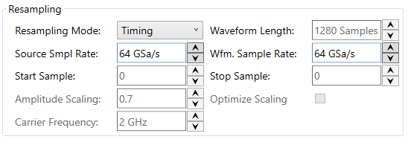
Waveform Generation
Beware of…
Digitization Noise
Dynamic Range
DC component
Cryptic Keysight errors caused by waveform granularity requirements
Practical Note: We’ve got code that does all this for you now. I have done something useful!

Slide 24
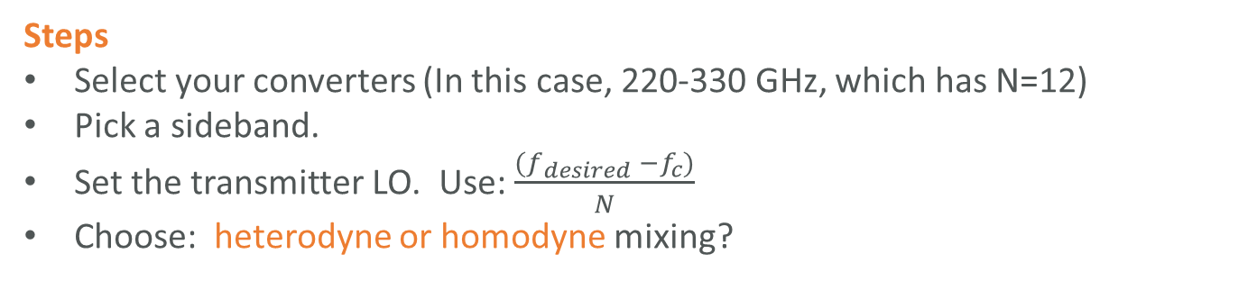
Setting the LO frequencies
Remember this little diagram?
Steps
Select your converters (In this case, 220-330 GHz, which has N=12)
Pick a sideband.
Set the transmitter LO. Use: $\frac{{(f}_{desired} −f_{c})}{N}$
Choose: heterodyne or homodyne mixing?

Slide 25
Heterodyne Mixing vs Homodyne Mixing
Which sideband is this one again?
Heterodyne Mixing: Mix your signal with a different center frequency. Sidebands stay split.
Homodyne Mixing: A special case where you mix with the same frequency. Combines sidebands together.
Practical Problem: You must lock the oscillators to perform Homodyne mixing. For us, that means syncing the PSGs together and waiting 45 minutes after power-up.

Slide 26
Setting up the ‘scope
Check all the bandwidths.
Key Takeaways
Watch out for sidebands! Filter them or sample them, but don’t alias them!
Use the built-in front-end filter to cut out unwanted noise.
Make sure the front-end isn’t cutting out your signal.

Slide 27
Communication Waveform Generation
Terms and conditions definitely apply.
Requirements
Sample rate is between 54 and 65 Gsa/s.
Integer number of carrier cycles per waveform.
Waveform length (in samples) is a multiple of 256.
Waveform length (in time) is an exact multiple of the sample period.
Note: All but the first requirement stem from the need to send frames back-to-back.
Also Note: These requirements can’t all be simultaneously met for arbitrary combinations of data length, carrier frequency, and bit rate. → Change the carrier frequency.

Slide 28
Communication Waveform Generation
Terms and conditions definitely apply.
Requirements
Sample rate is between 54 and 65 Gsa/s.
Integer number of carrier cycles per waveform.
Waveform length (in samples) is a multiple of 256.
Waveform length (in time) is an exact multiple of the sample period.
Note: All but the first requirement stem from the need to send frames back-to-back.
Also Note: These requirements can’t all be simultaneously met for arbitrary combinations of data length, carrier frequency, and bit rate. → Change the carrier frequency.

Slide 29
Communication Waveform Generation

Slide 30
?
QUESTIONS

